Slide 1
Billing and Documentation
2023

Slide 4
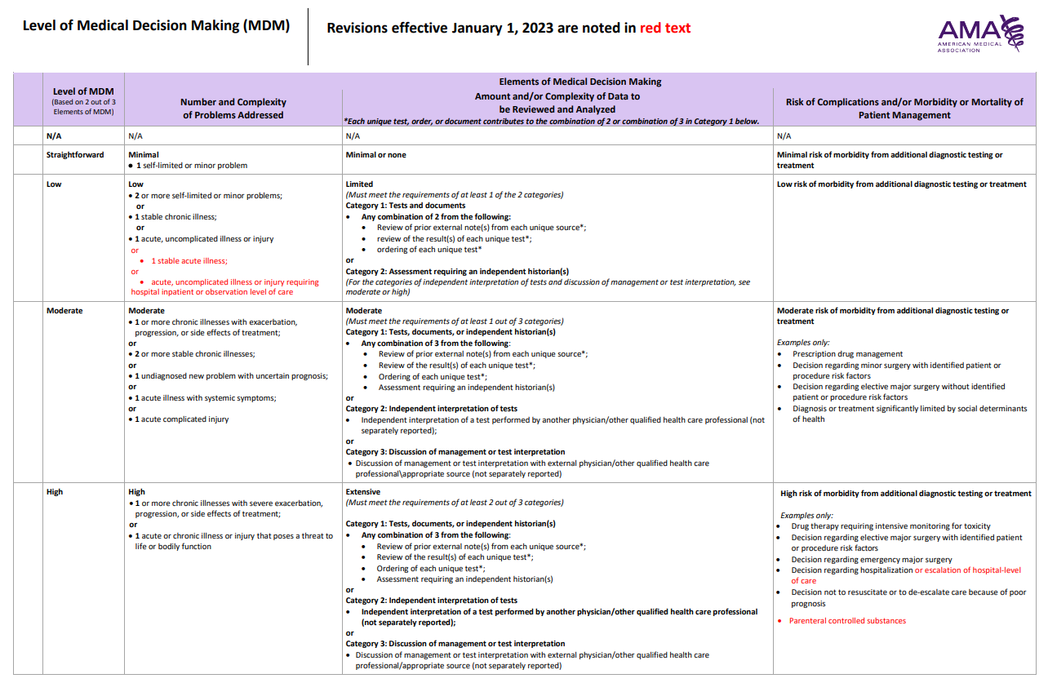
New /established (3yr)
99202/99212
99203/99213
99204/99214
99205/99215

Slide 5
1. Number and Complexity of Problems Addressed
Note:
reviewing problem and saying continue current medications = problem “addressed”

Slide 6
2. Amount and Complexity of data reviewed
Limited:

Slide 7
2. Amount and Complexity of data reviewed - examples

Slide 8
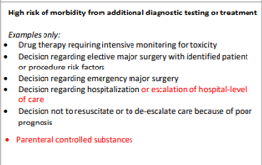
3. Risk of Complications and/or Morbidity/Mortality

Slide 10
New /established (3yr)
99202/99212
99203/99213
99204/99214
99205/99215

